Slide 1

Exploratory Data Analysis (EDA) Report
Cellula Internship - Week 1
Presented by: Group 3

Slide 2
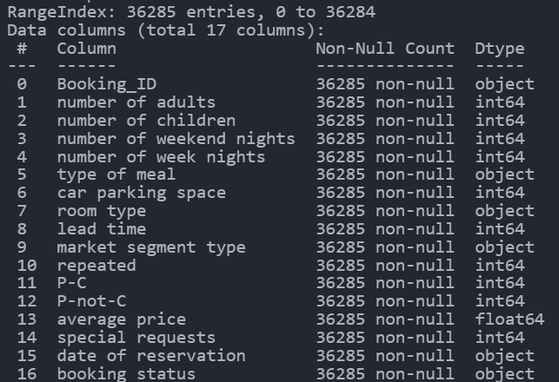
Understanding the Dataset
Number of Rows: 36295
Number of Columns: 16
Dataset Description:
This dataset contains hotel booking information, including customer preferences, booking details, and cancellations.
The goal of this analysis is to identify patterns, trends, and insights that can improve booking management.

Slide 3
Features Description:-
1. Booking ID: A unique identifier for each booking. (Costing Feature)
2. Number of adults: The number of adults included in the booking.
3. Number of children: The number of children included in the booking.
4. Number of weekend nights: The number of weekend nights (Friday and Saturday) included in the booking.
5. Number of week nights: The number of weeknights (Sunday to Thursday) included in the booking.
6. Type of meal: The type of meal plan chosen for the booking. (plan 1/2/3 or not-selected)
7. Car parking space: Car parking space requested or not.
8. Room type: The type of room booked. (Types [1 - 7])
9. Lead time: The number of days between the booking and check-in dates.

Slide 4
Features Description:-
10. Market segment type: The market segment from which the booking originated, such as ['Offline’, 'Online' 'Corporate’, 'Aviation’, 'Complementary'].
11. Repeated: This indicates whether the booking is from a repeat guest.
12. P-C: The number of previous booking cancellations.
13. P-not-C: The number of previous non-cancellations.
14. Average price: The average price per night for the booking.
15. Special requests: The number of special requests made by the guest.
16. Date of reservation: The date of reservation.
17. Booking status: The current booking status, such as ['Not Canceled' 'Canceled'].

Slide 5
Summary:-
The dataset has:
No Nulls.
No Duplicates.
Costing features that should be removed: (Booking_ID).
Features should be encoded:
  (type of meal, room type, market segment type, booking status).
New features:
  (family_size, total_nights, reservation_year, reservation_month, reservation_day)

Slide 6
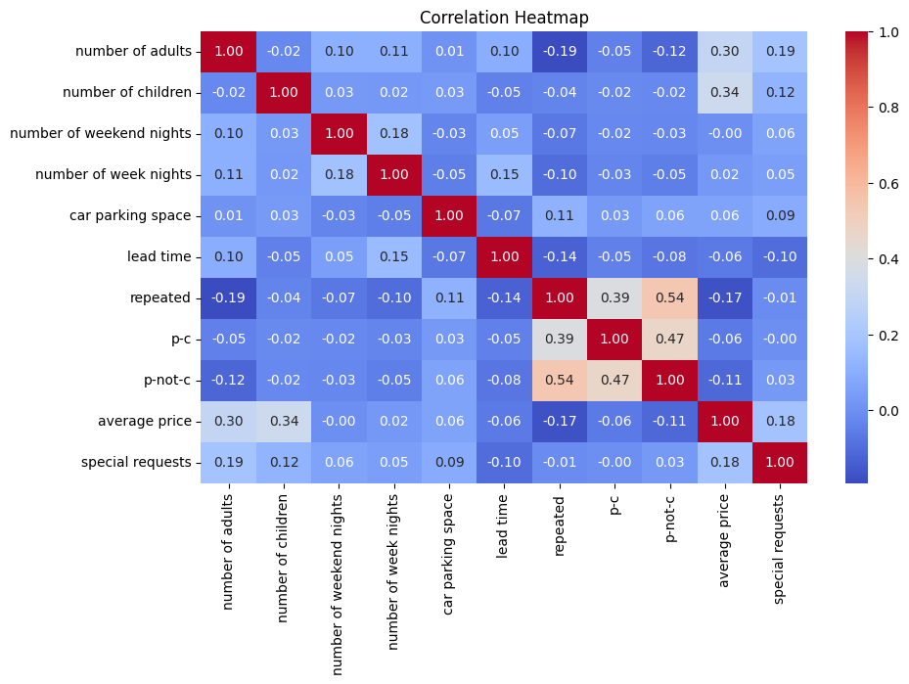
Feature Correlations
A correlation matrix helps identify relationships between numerical variables.
Strong positive or negative correlations indicate dependencies between variables.
Key Insights:
Lead time may correlate with booking status.
Special requests and pricing could be linked.

Slide 7
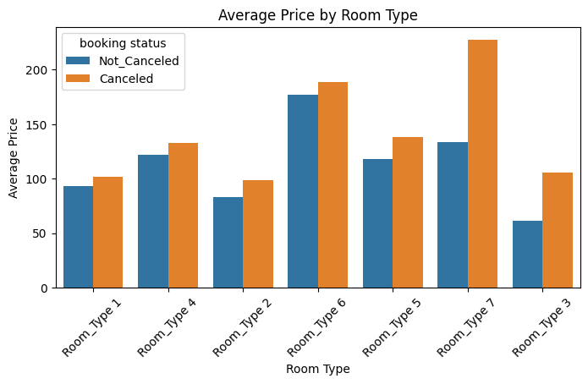
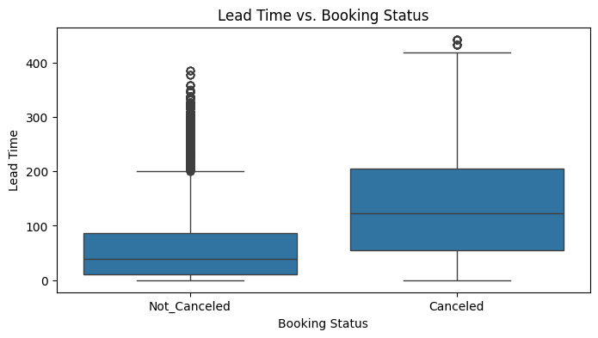
Key Relationships in the Data
Exploring relationships between variables helps uncover dependencies.
Questions Explored:
Does the lead time affect booking status?
How does the average price vary by room type?

Slide 8
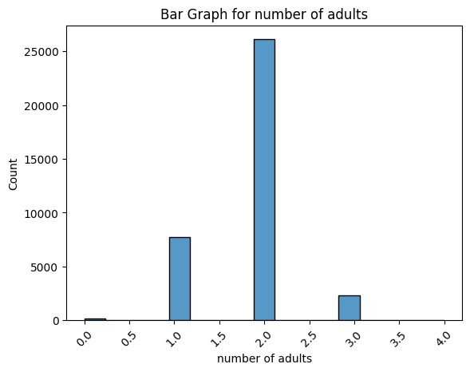
Visualisation
Number of Adults: The most common is 2 adults, followed by 1.
Number of Children: The majority have 0 children. Small numbers have 1 or 2 children, with very few having 3 or more.
- Car Parking Space: Most entries have no car parking space.

Slide 9
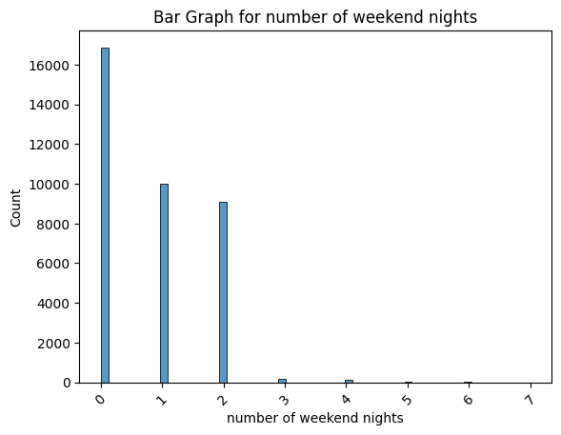
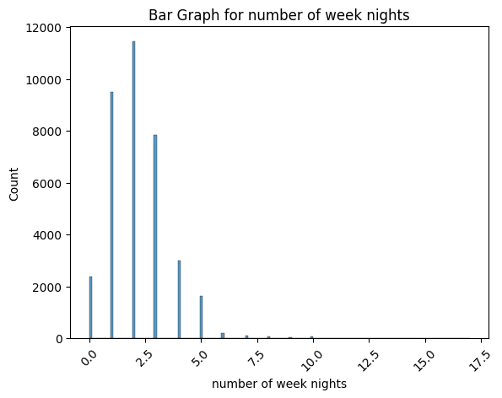
Visualisation
Number of Weekend Nights: Most common entries are 0, 1, or 2 weekend nights. Very few entries have 3 or more.
- Number of Week Nights: The majority of occurrences are around 2.5 weeknights, with fewer entries as the number of weeknights increases.

Slide 10
Visualisation
Type of Meal: "Meal Plan 1" is the most common, followed by "Not Selected”.
Room type: most common is 1, followed by 4.
Repeated: The vast majority of entries are not repeated.
P-C & P-not-C: Most data points are concentrated at the value 0.

Slide 11
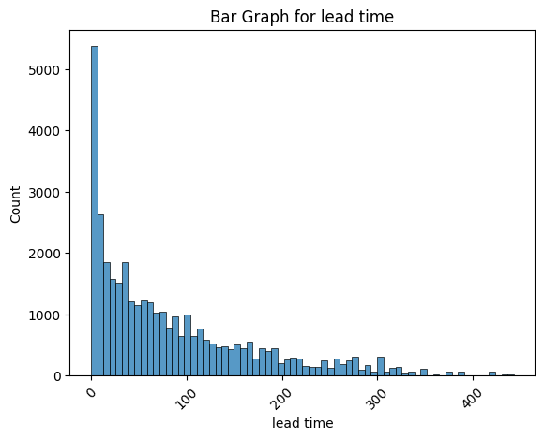
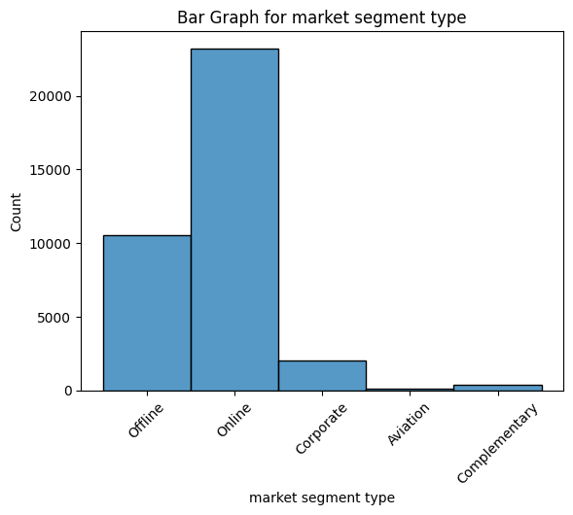
Visualisation
Market Segment Type: Online segment is the most common, followed by Offline.
Lead Time: The majority of reservations have shorter lead times.

Slide 12
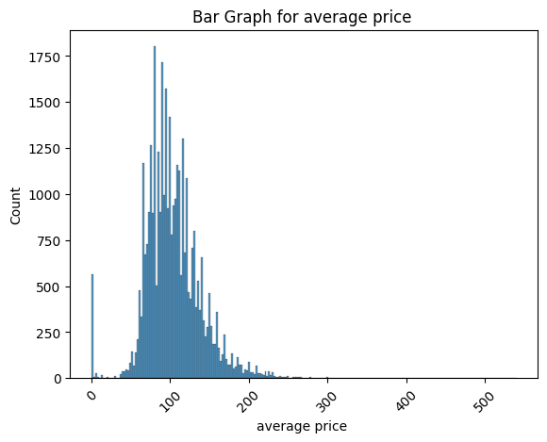
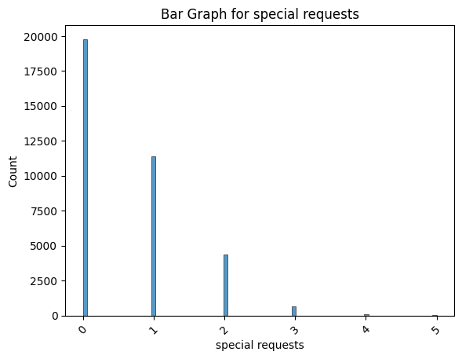
Visualization
Average Price: The majority of entries have lower average prices (Mean = 103).
Special Requests: Majority have 0 or 1 special request. Higher numbers of special requests are less common.

Slide 13
Visualisation
Booking Status: Most bookings are not canceled.
Family Size: Majority is 4 or less.
Total nights: The majority is 5 or less.
Reservation year: The most common is 2018, followed by 2017.
Reservation month: most entries are reserved in (August, September, October).

Slide 14
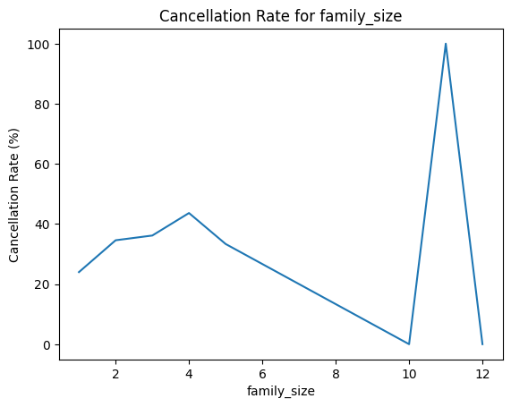
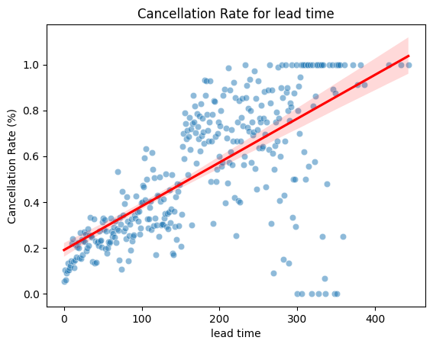
The relationship summary between features and target
Family Size:
- Below 4: Higher family size results in a higher cancellation rate.
- Below 10: Higher family size results in a lower cancellation rate.
- Above 10: High cancellation rate.
Lead Time:
Most cancellations occur for bookings with long lead times

Slide 15
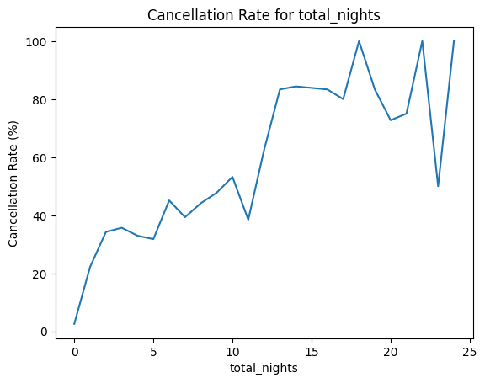
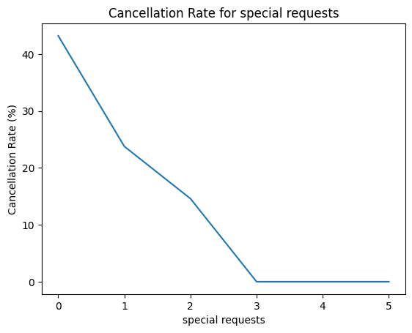
Total Nights:
A higher number of total nights results in a higher cancellation rate.
New guests and Reservations without parking space
Have a higher likelihood of cancellation.
Special Requests:
More special requests result in a lower cancellation rate.

Slide 16
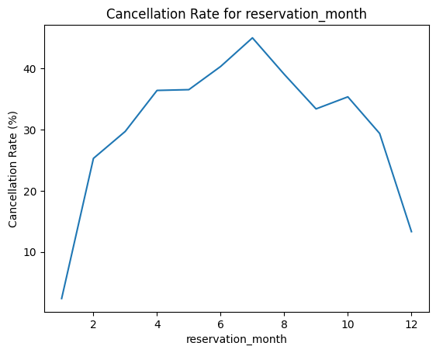
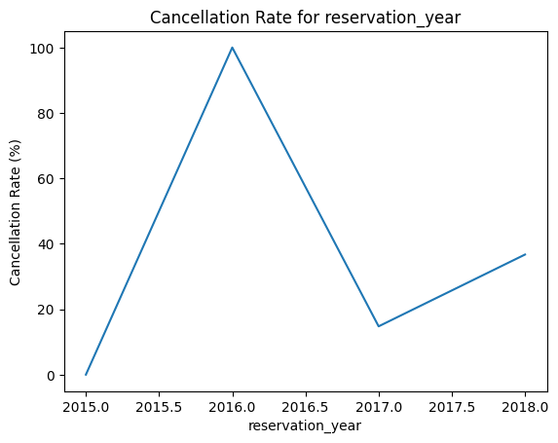
Reservation Month:
Cancellation rate increases during the first 7 months and then decreases.
Increases between 2015-2016, decreases between 2016-2017, and then increases again.
Reservation Year:

Slide 17
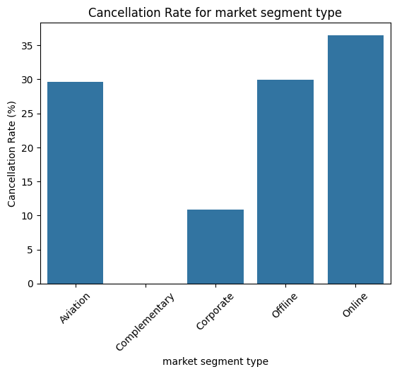
Market Segment Type:
The online segment has the highest cancellation rate, while the complementary segment rarely cancels.

Slide 18

Conclusion & Recommendations
Conclusion:
The data reveals key trends that can help improve booking strategies.
Cancellation rates are influenced by lead time, price, and customer preferences.
Lead time and room type are key factors influencing booking cancellations.
Longer lead times and lower-priced rooms are associated with higher cancellation rates.
Recommendations:
To reduce cancellations, consider offering discounts for shorter lead times.
Adjust pricing strategies based on demand for different room types.
Provide personalized incentives for guests with multiple special requests.
Offer discounts for shorter lead times.
Promote higher-priced rooms to reduce cancellations.
Adjust pricing strategies based on room type demand.

